Slide 1
Waste management – citizens engagement
Fragiskos Fourlas (1059336)
Marios Stamatopoulos (1059383)
Nikos Panagiotopoulos (1053552)

Slide 2
OUTLINE
Problem
Solution
Market Fill
Market Gap
Our Proposal

Slide 3
Problem
No information to plan waste collection
Difficult to supervise the whole process
Increasing generation of waste - low recycling rate

Slide 4
SOLUTION
Location/fullness of bins are known in real-time
Statistics can be easily examined for decisions
Citizens are motivated to actively involve
Optimal path for truck

Slide 5
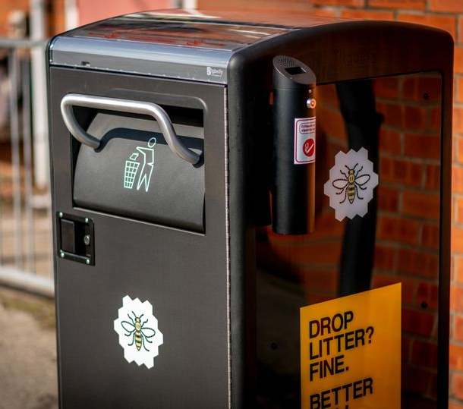
Market Fill
SENSONEO
Installations in 60 countries
Produces IoT-compatible sensors
Digitizing infrastructure w/ tags (RFID, NFC, QR, etc.)
Path planning for garbage trucks
Monitoring & Analytics platform
Academic Community
Use of AI
Solar Power
Remote bin locking

Slide 6
Market Gap – Citizen Engagement
Announce Bounty
(e.g. Tilting bin, Empty battery)
Award Points
Citizens Redeem for Vouchers

Slide 7
Market Gap – Citizen Engagement
Reward Waste Separation & Recycle
Award Points
(/kg of Recyclable Waste)
Citizen Uses Proper Recycling Bin

Slide 8
Our Proposal
Monitoring | Collection path planning | Citizen contribution
Near real-time monitoring of the whole infrastructure | Empty only full bins AI fill level prediction | Points Reward-System
Adapted apps for: Municipalities, Citizens, Truck Drivers | 30-60% Route reduction 50%+ Reduction on cost Investment return in 12 months | Recycling Assisting Charging

Slide 9
Sensors needs
Fullness of each bin
Real time position of bin and trash truck
Air quality

Slide 10
sEnsors used
LORAWAN Micro GPS | SENSONEO ultrasonic | ENVITUS AIR QUALITY
Battery (3 years) | 3-170 cm | O3,CO,SO2
15 km range | Temp. Measurement | NO2
WIFI triangulation | Integrated accelerometer | Temperature

Slide 11
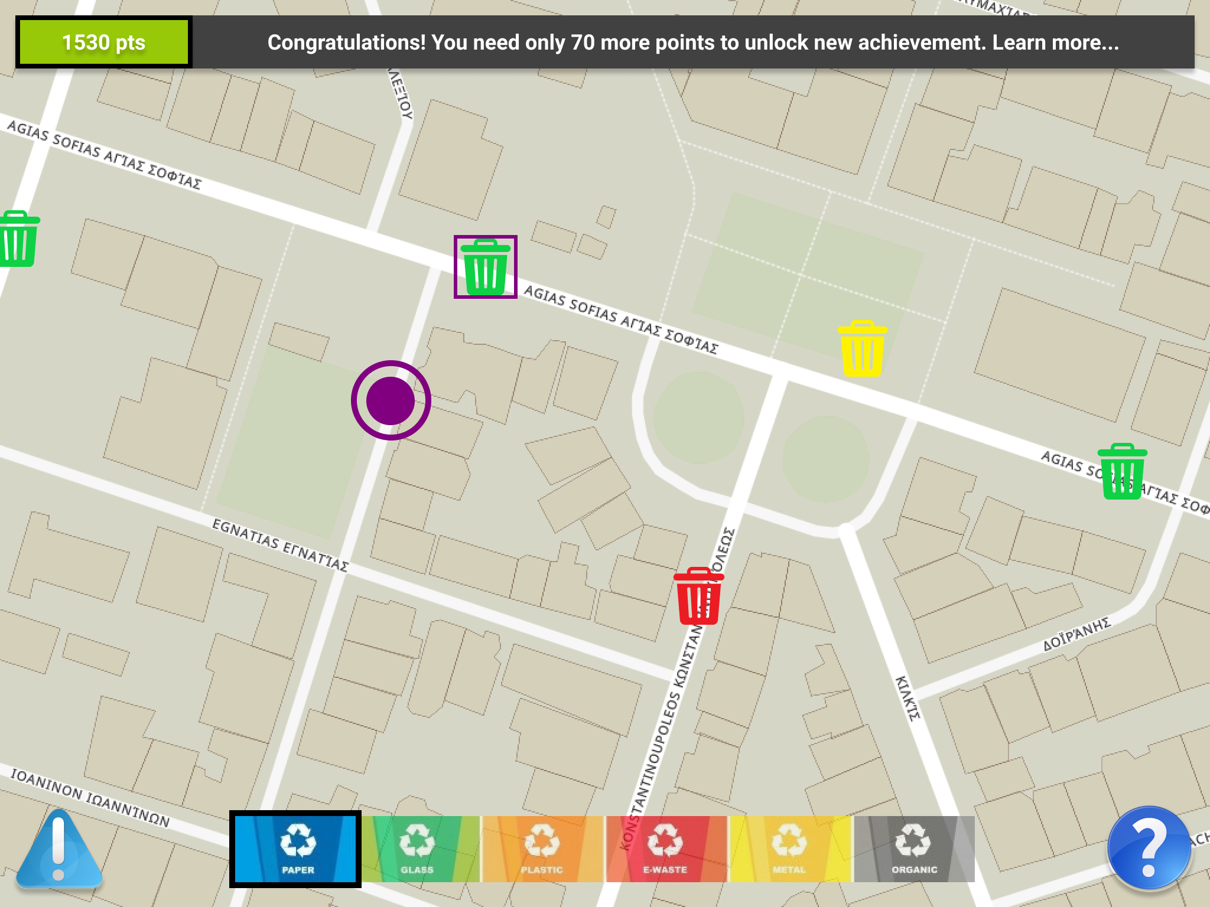
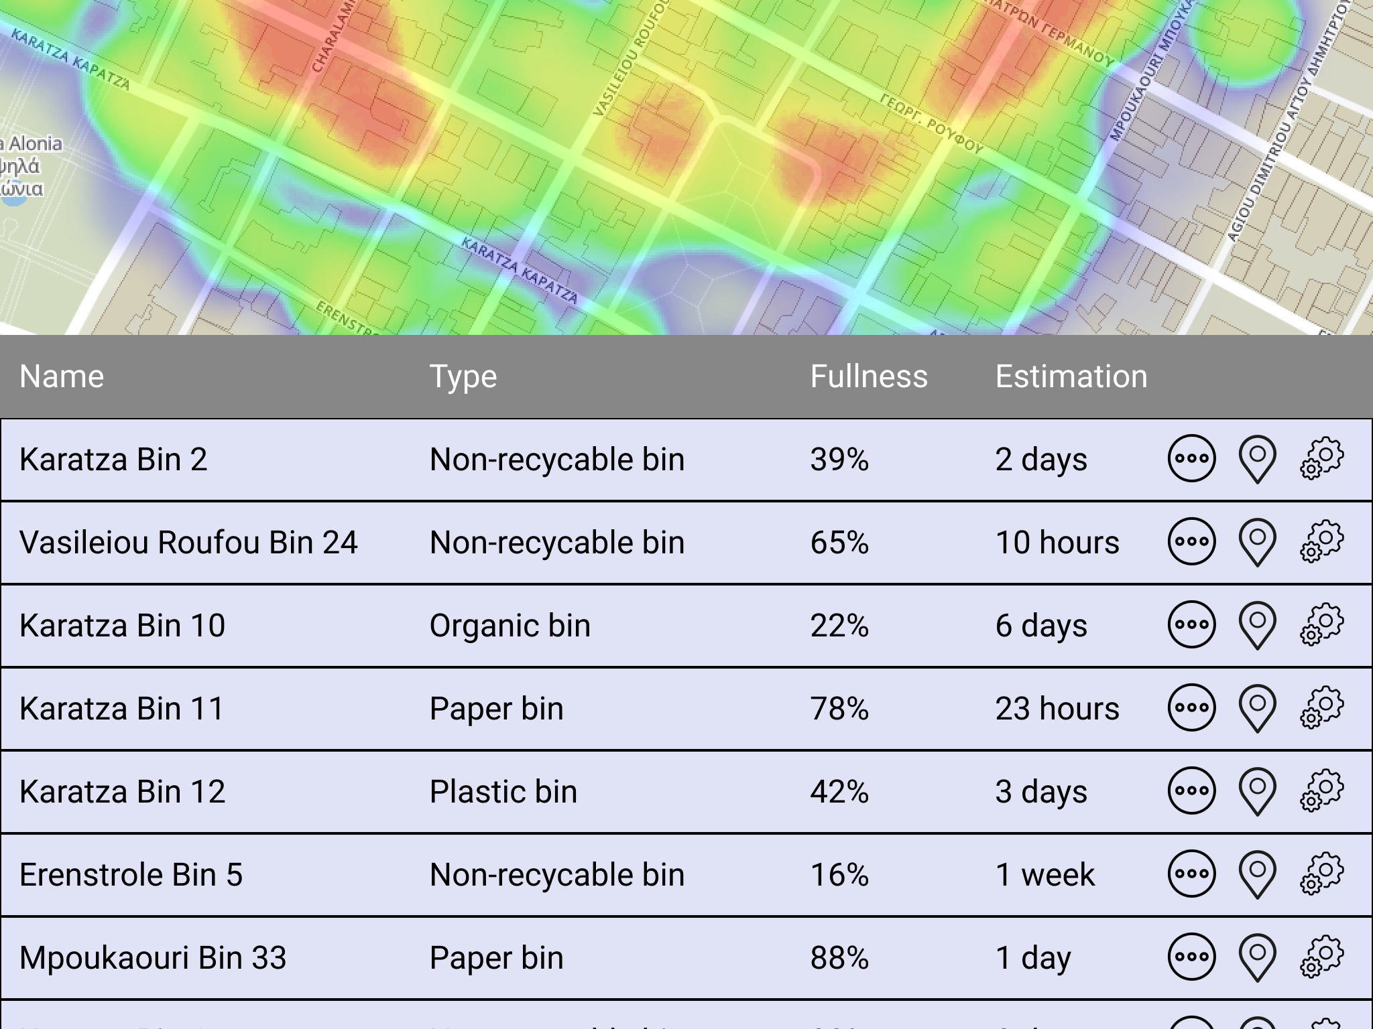
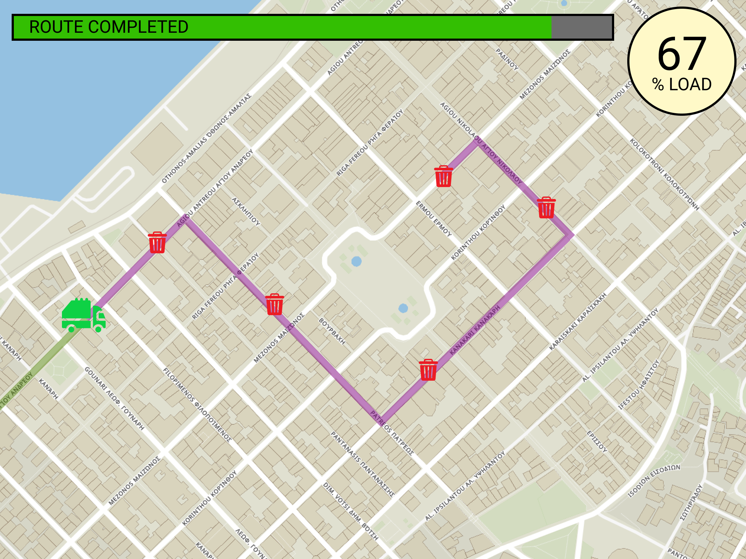
APP
User screen
Management screen
Truck screen

Slide 12

Questions?

